Slide 1



Overview of EM Guided Waves
and Microwave Measurements
Steven Anlage
http://www.cnam.umd.edu/anlage/AnlageMicrowaveMeasurements.htm

Slide 2
Outline
Guided Waves
Transmission Lines
Characteristic Impedance
Waveguides
Network Analysis
Linear vs. Nonlinear Properties
Spectrum Analysis
Resonator Measurements

Slide 3
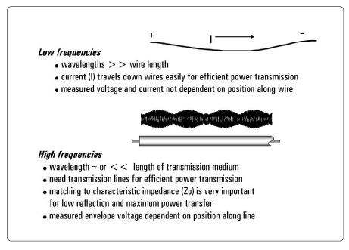
Electrical Signals at Low and High Frequencies

Slide 4
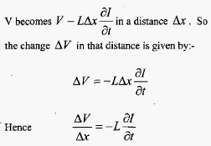
Transmission Lines
Transmission lines carry microwave signals from one point to another
They are important because the wavelength is much smaller than the length of typical T-lines
used in the lab
You have to look at them as distributed circuits, rather than lumped circuits
V
The wave equations

Slide 5

Transmission Lines
Wave Speed
Take the ratio of the voltage and current waves
at any given point in the transmission line:
= Z₀
The characteristic impedance Z₀ of the T-line
Reflections from a terminated transmission line
Reflection
coefficient
Z₀
Z_{L}
Open Circuit Z_{L} = ∞, Γ = 1 e^{i0}
Some interesting special cases:
Short Circuit Z_{L} = 0, Γ = 1 e^{iπ}
Perfect Load Z_{L} = Z₀, Γ = 0 e^{i?}
These are used in error correction measurements to characterize non-ideal T-lines

Slide 6
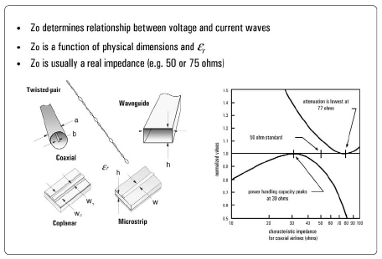
Transmission Lines and Their Characteristic Impedances

Slide 7
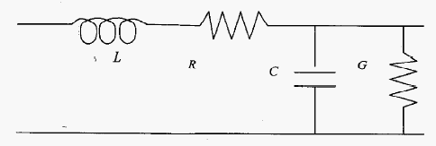
Transmission Lines, continued
The power absorbed in a termination is:
Model of a realistic transmission line including loss
Shunt
Conductance
Traveling
Wave
solutions
with

Slide 8
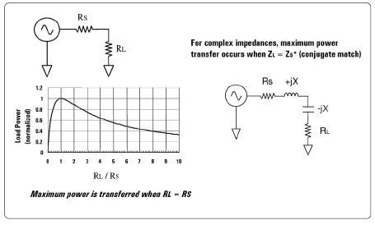
How Much Power Reaches the Load?

Slide 9
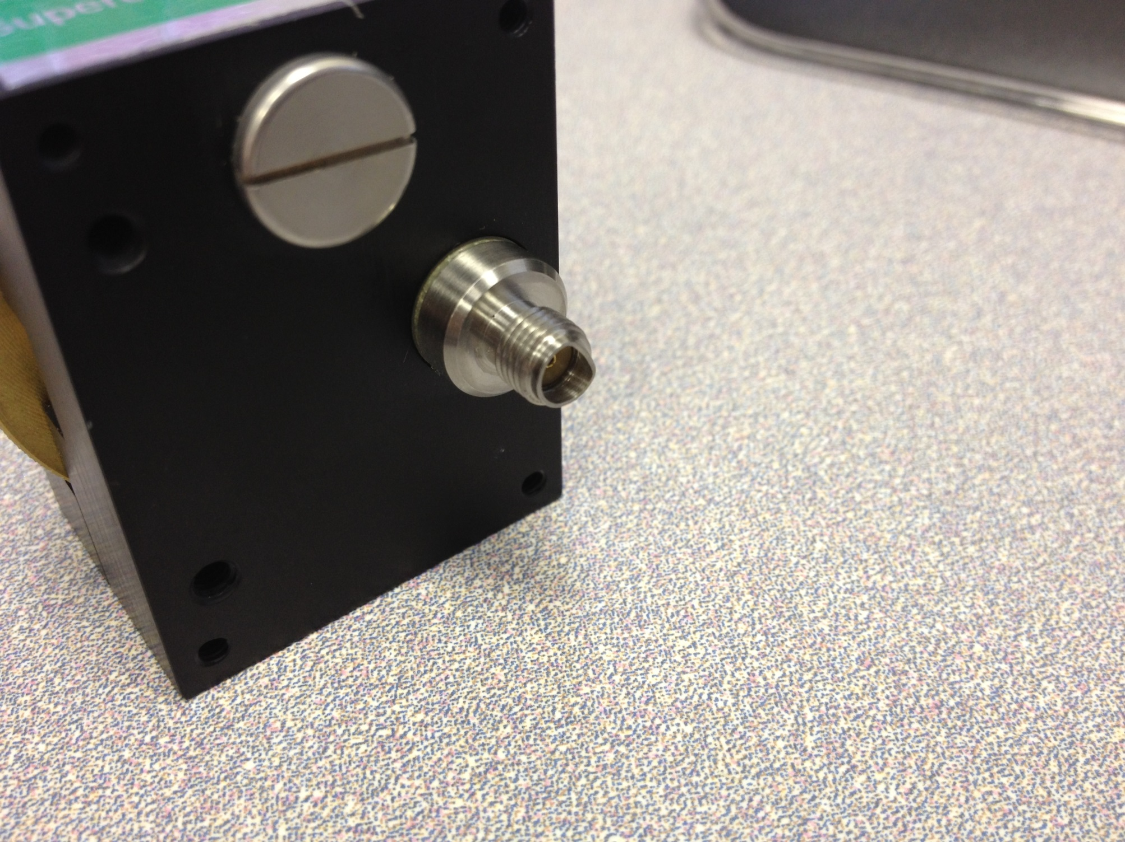
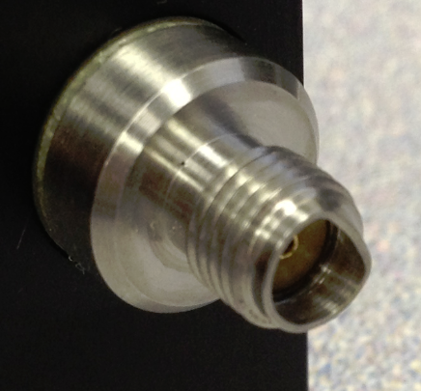
The Need for Care with SMA Connectors

Slide 10
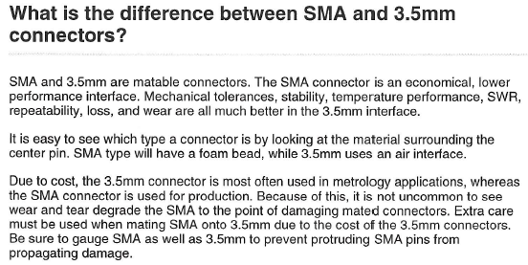
Microwave Connectors
Connector Name | Bandwidth (GHz) | “Compatible” with | Found in
1 mm | 110
V (1.85 mm) | 60 | 2.4 mm | Corbino expt.
2.4 mm | 60 | V | PNA
K (2.92 mm) | 40 | 3.5 mm*, SMA* | BlueFors fridge
3.5 mm | 26.5 | K, SMA* | PNA
SMA | 18 or 25 | 3.5 mm, K | All over…
* Means “mates with damage”
See https://www.microwaves101.com/encyclopedias/microwave-connectors#overview

Slide 11


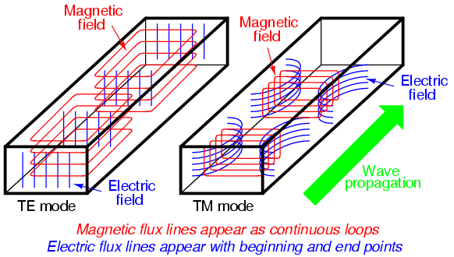
Waveguides
H
Rectangular metallic waveguide

Slide 12

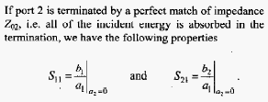
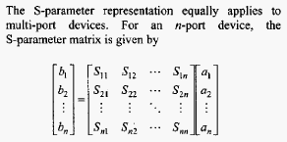
Network Analysis
Assumes linearity!

Slide 13
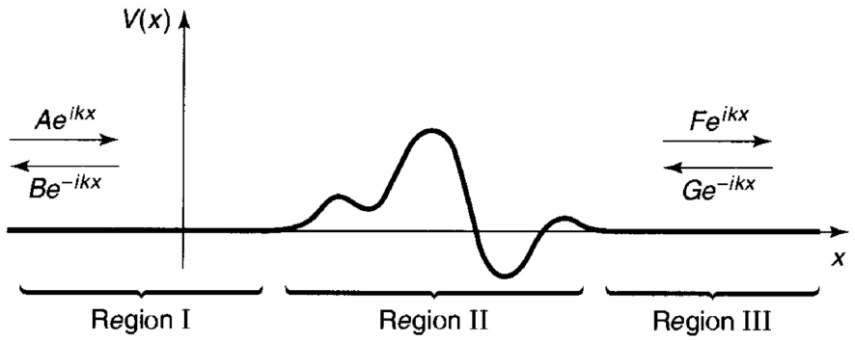
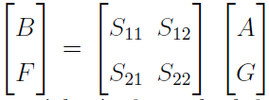


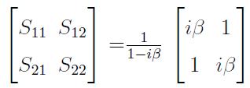
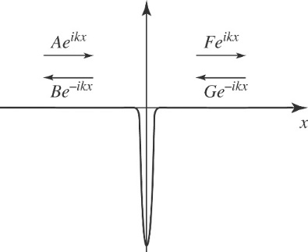

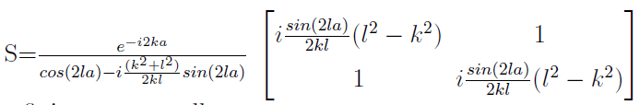


Quantum Scattering in One Dimension
$$V\left(x\right)=−α δ(x)$$
Griffiths 3rd Edition, problem 2.53
https://www.physics.umd.edu/courses/Phys402/AnlageFall22/Quantum%20Scattering%20in%20One%20and%20Three%20Dimensions.pdf

Slide 14
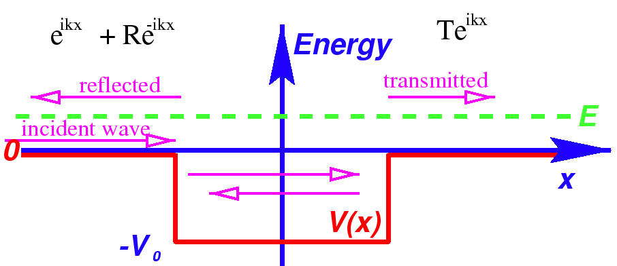




Scattering From a Finite Potential Well in 1D Quantum Mechanics
$${Ψ_{I}\left(x,t\right)=Ae}^{ik\left(x−ωt\right)}+Be^{−ik\left(x+ωt\right)}$$
$${Ψ_{Transmitted}\left(x,t\right)=Fe}^{ik\left(x−ωt\right)}$$
$$a$$
$$−a$$

Slide 15

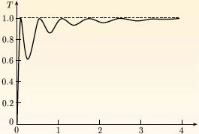

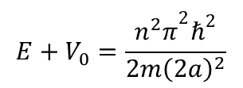
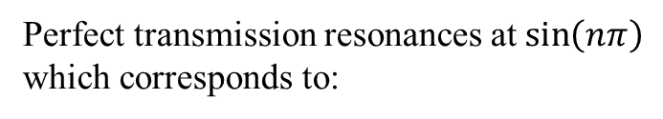


Transmission Probability vs. Incident Particle Energy
$$T={\left|F/A\right|}^{2}$$
Ramsauer-Townsend
Effect
$$E/V_{0}$$
Parameters used:
m = mass of electron
V₀ = 8.6 eV
2a = 1 nm
Perfect transmission resonances at $\sin\left(nπ\right)$
which corresponds to:
$$E+V_{0}=\frac{{n^{2}π}^{2}ℏ^{2}}{2m{\left(2a\right)}^{2}}$$
$$\text{with} n=1, 2, 3,…$$
https://www.open.edu/openlearn/science-maths-technology/science/physics-and-astronomy/scattering-and-tunnelling/content-section-3.5

Slide 16
N-Port Description of an Arbitrary Enclosure
V₁ , I₁
N Ports
Voltages and Currents,
Incoming and Outgoing Waves
N – Port
System
V_{N} , I_{N}
S matrix
Z matrix
Complicated Functions of frequency
Detail Specific (Non-Universal)

Slide 17
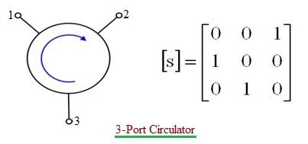
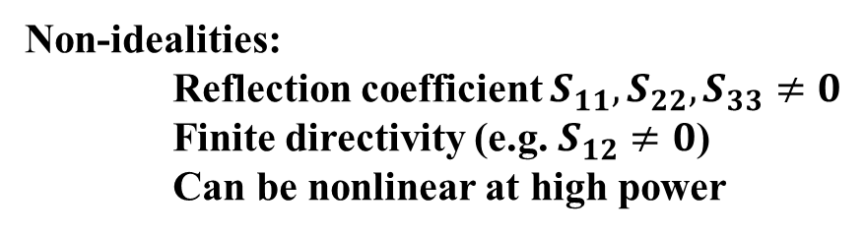
Common Microwave Devices and How They Work
Microwave devices and measurements boil down to simply separating left-going and right-going waves on a transmission line
Circulator
Non-idealities:
Reflection coefficient $S_{11},S_{22},S_{33}≠0$
Finite directivity (e.g. $S_{12}≠0$)
Can be nonlinear at high power

Slide 18
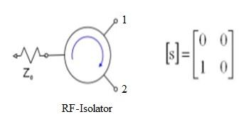
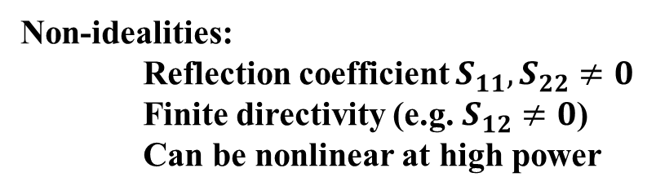
Common Microwave Devices and How They Work
Microwave devices and measurements boil down to simply separating left-going and right-going waves on a transmission line
Isolator = Circulator + matched load on port 3
Non-idealities:
Reflection coefficient $S_{11},S_{22}≠0$
Finite directivity (e.g. $S_{12}≠0$)
Can be nonlinear at high power

Slide 19
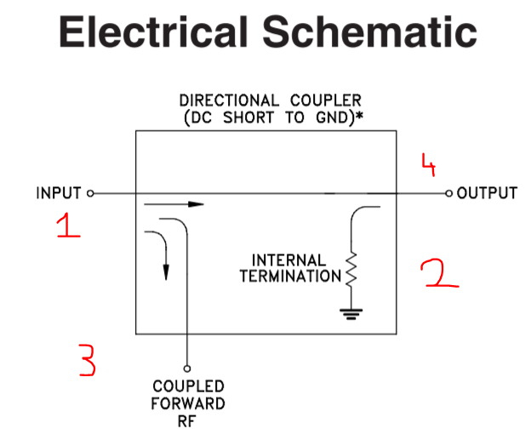
Common Microwave Devices and How They Work
Directional Coupler
Most of the signal goes through
The sampled reflected (left-going) wave is absorbed
A small amount (e.g. -10 dB, or -20 dB) of the right-going wave is sampled off for measurement

Slide 20
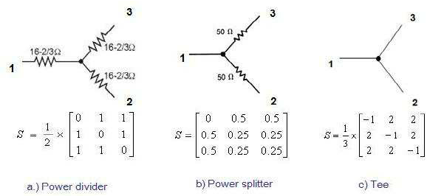
Common Microwave Devices and How They Work
Divider / Splitter / Combiner / Tee

Slide 21
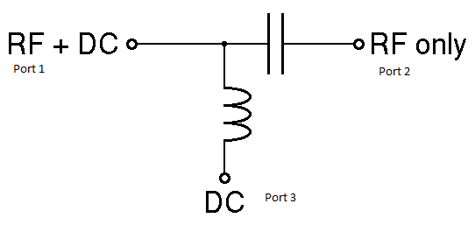
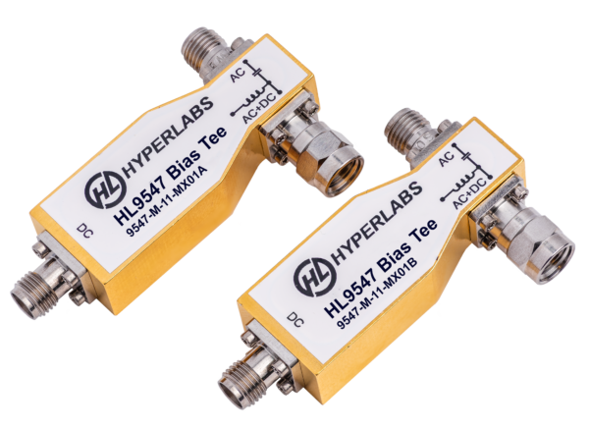
Common Microwave Devices and How They Work
Bias tee – Combines / Separates microwave and DC / low-frequency signals
Bias tees are built into the network analyzers
The DC/low-frequency connection is
on the back-panel

Slide 22
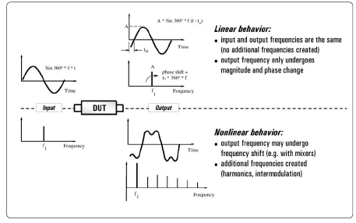
Linear vs. Nonlinear Behavior

Slide 23
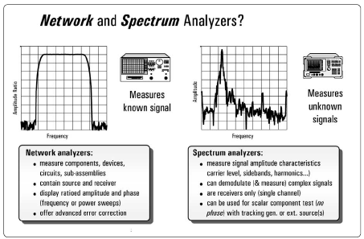
Network vs. Spectrum Analysis

Slide 24
Resonator Measurements
Traditional Electrodynamics Measurements
input
output
sample
rf currents
Microwave
Resonator
Cavity
Perturbation
~ microwave
wavelength
λ
B
H_{rf}
inhomogeneities
Sample
These measurements
average the properties
over the entire sample
transmission
T₁
T₂
Quality Factor
Q = E_{stored}/E_{dissip.}
Q = f₀ / δf
δf
δf’
frequency
f₀
f₀’
Δf = f₀’ – f₀ ∝ Δ(Stored Energy)
Δ(1/2Q) ∝ Δ(Dissipated Energy)

Slide 25

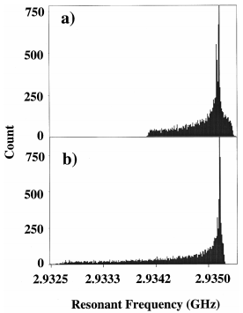


Electric and Magnetic Perturbations
Electric Field Pert.
Magnetic Field Pert.
E
E
Sample
Sample
B
B
ε₁ - i ε₂
σ, ρ/t
R_{s} + i X_{s}
μ₁ + i μ₂
σ, ρ/t
R_{s} + i X_{s}
Varying capacitance (ε₁) and
inductance (μ₁) change the stored
energy and resonant frequency Δf
Sphere in
electric field
Varying sample losses (ρ/t,
tanδ = ε₂/ε₁, μ₂) change the quality
factor (Q) of the microscope
Pin in
electric field
$$\vec{E}$$
sphere
Δf = f₀’ – f₀ ∝ Δ(Stored Energy)
Δ(1/2Q) ∝ Δ(Dissipated Energy)

Slide 27
The Variable-Spacing Parallel Plate Resonator
Vary s
s: contact –
~ 100 μm
in steps of
10 nm to 1 μm
Principle of Operation: Measure the resonant frequency, f₀, and the
quality factor, Q, of the VSPPR versus the continuously variable
thickness of the dielectric spacer (s), and to fit them to theoretical forms
in order to extract the absolute values of λ and R_{s}.
The measurements are performed at a fixed temperature
In our experiments L, w ~ 1 cm

Slide 28
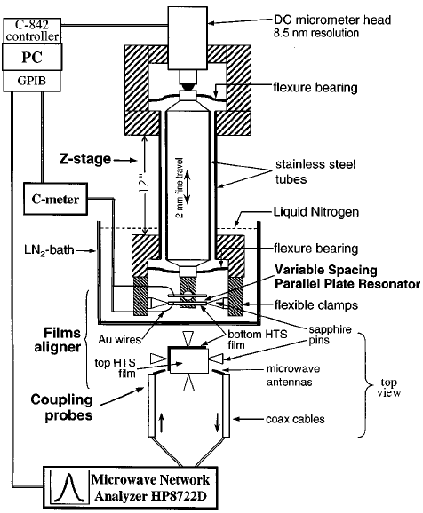
The VSPPR Experiment
Films held and aligned by two sets
of perpendicular sapphire pins
Dielectric spacer thickness (s)
measured with capacitance meter

Slide 29
VSPPR: Theory of Operation
Superconducting samples
Resonant Frequency
Quality Factor
SC Trans.
line resonator
fringe
effect
f* is a reference frequency
Assumes: 2 identical and uniform films, local electrodynamics, R_{s}(f) ~ f²
V. V. Talanov, et al., Rev. Sci. Instrum. 71, 2136 (2000)
US Patent # 6,366,096

Slide 30
High-T_{c} Superconducting Thin Films at 77 K
λ fit: 257 ± 25 nm
Mutual Inductance Measurements
(λ₁+λ₂)/2 = 300 ± 15 nm
R_{s} fit: 200 ± 20 μΩ @ f* = 10 GHz
L = 9.98 mm, w = 9.01 mm, film thickness d = 760 ± 30 nm, T_{c} = 92.4 K

